Slide 1
LECTURE 10: TEXT AS DATA
November 29, 2016
SDS 136
Communicating with Data
Portions of this slide deck adapted from J.Chuang University of Washington

Slide 2
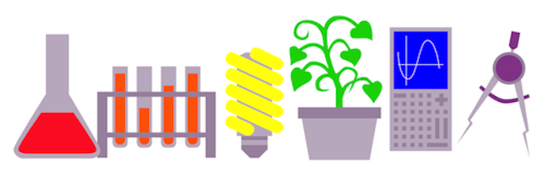
Announcements 1/3
Got ideas about how Smith could build
a more inclusive STEM program?
Science Center Committee on Diversity (SCCD)
Listening Session
Noon on Weds in Sabin-Reed 101
Pizza provided!
RSVP to vjoseph@smith.edu

Slide 3

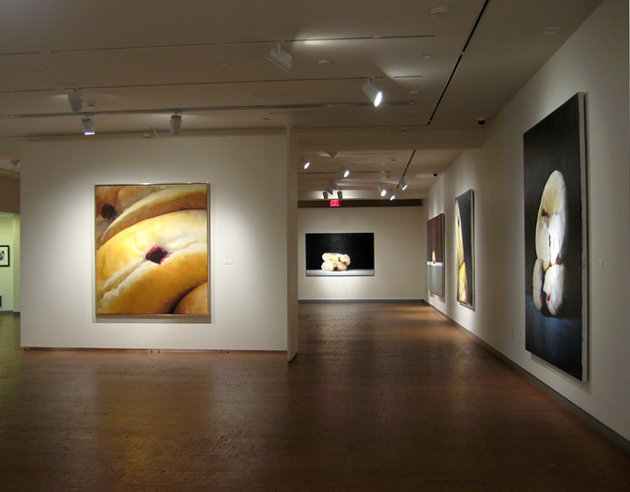
Announcements 2/3
Thursday will be our final visit to SCMA
Topic: visual analysis and metadata (and bringing together all we’ve learned to analyze real museum data)
Meet in the Hillyer Atrium at 9:00 sharp!

Slide 4
Announcements 3/3 - Final Project Deliverables
Nov. 1st - FP1: Topic Brainstorm
Nov. 15th - FP2: Persona and Critical Review
Nov. 29th - FP3: Initial Prototype
Dec. 8th - FP4: Revised Prototype
Dec 15th – Final Project Reception (demos!)
Dec. 22nd - FP5: Final Write-Up

Slide 5
Outline
What is text data?
Why visualize text?
Techniques
Lab

Slide 6

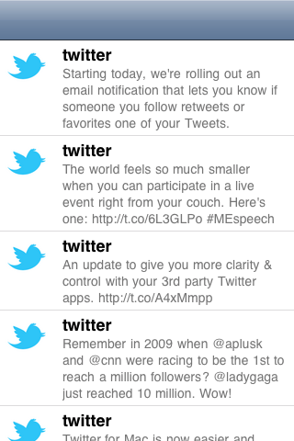
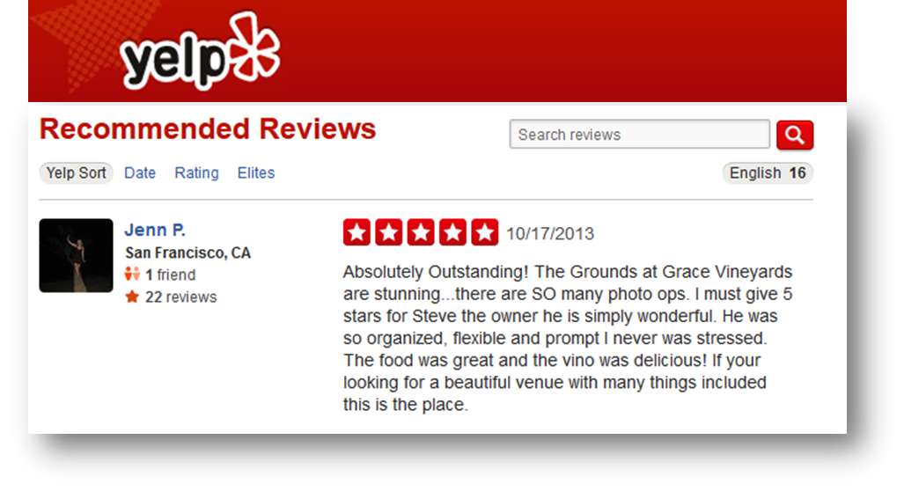
What is text data?
Documents
Articles, books and novels
E-mails, web pages, blogs
Text snippets
Tweets, SMS messages
Tags, comments, profiles
And more...
Computer programs, logs
Collections of documents
This slide!

Slide 7

Discussion
Question: what are some characteristics of text data?
Answer:
Often high dimensional (over 228,000 words in OED)
Packed with meaning and relationships:
Correlations: Hong Kong, San Francisco, Bay Area
Order: April, February, January, June, March, May
Membership: Tennis, Running, Swimming, Hiking, Piano
Hierarchy, antonyms & synonyms, entities, …

Slide 8
Why visualize text data?
Understand – read a document
Summarize – get the “gist” of a document
Cluster – group together similar contents
Quantify – convert to numerical measures
Correlate – compare patterns in text to those in other data, e.g., test scores with conversations on social media

Slide 9
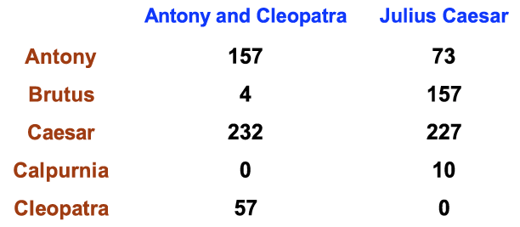
“Bag of words” model
Ignore ordering relationships within the text
A document ≈ vector of term weights
Each dimension corresponds to a term (10,000+)
Each value represents the relevance
For example, simple term counts
Aggregate into a document-term matrix

Slide 10

Example: health care reform
Recent history
Initiatives by President Clinton
Overhaul by President Obama
Text data
News articles
Speech transcriptions
Legal documents
What questions might you want to answer?

Slide 11
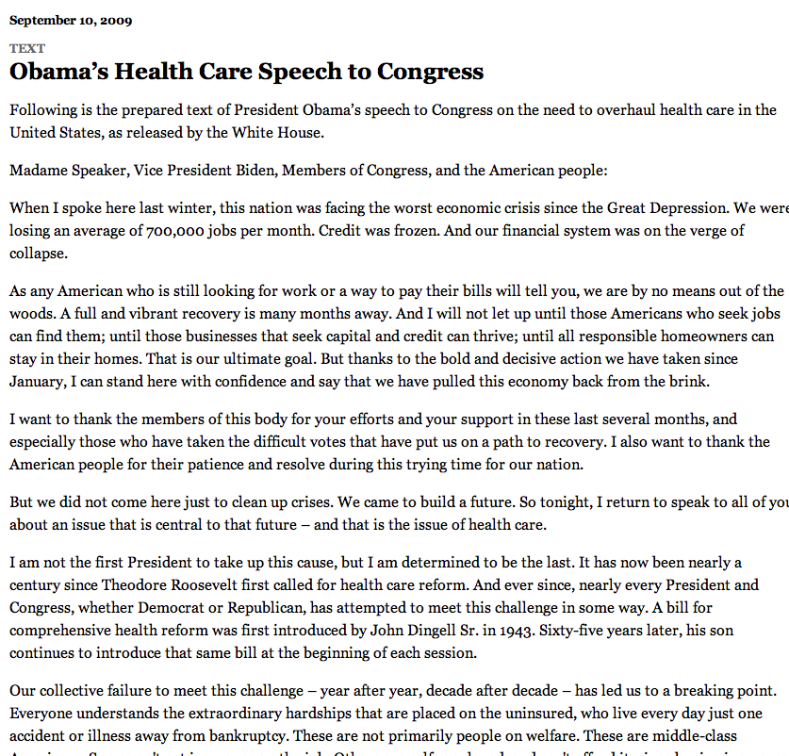
A concrete example

Slide 12
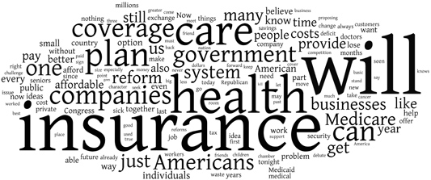
New York Times: Obama 2009
economix.blogs.nytimes.com/2009/09/09/obama-in-09-vs-clinton-in-93

Slide 13
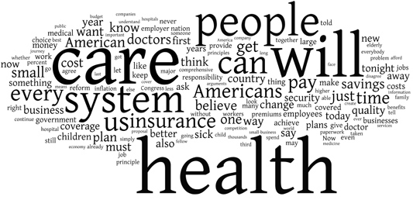
New York Times: Clinton 1993
economix.blogs.nytimes.com/2009/09/09/obama-in-09-vs-clinton-in-93

Slide 14
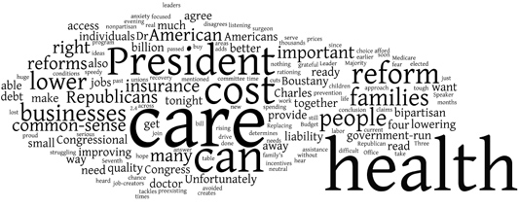
Comparison
Obama 2009
Clinton 1993
Rep. Charles Boustany of Louisiana 2009
economix.blogs.nytimes.com/2009/09/09/obama-in-09-vs-clinton-in-93

Slide 15
Word clouds
Strengths
Familiar to many people
Can help with “gisting” and initial query formation
Weaknesses
Does not show the structure of the text
Sub-optimal visual encoding (position is not meaningful)
Inaccurate size encoding (long words are bigger)
May not facilitate comparison (unstable layout)
Term frequency may not be meaningful

Slide 16
Flashback
Obama 2009
Clinton 1993
Rep. Charles Boustany of Louisiana 2009
economix.blogs.nytimes.com/2009/09/09/obama-in-09-vs-clinton-in-93

Slide 17
Weighting words
Term Frequency
tf_{td} = # of times term t appears in document d
TF-IDF: Term Frequency by Inverse Document Frequency
tf-idf_{td} = # of times term t appears in document d
# of times term t appears in all documents

Slide 18
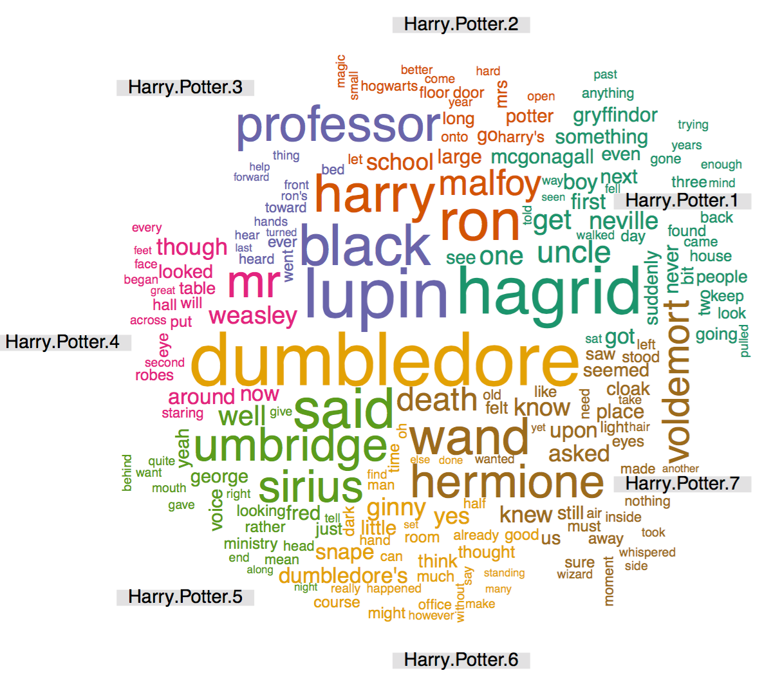
Frequency example: Happy Potter
http://casualconc.blogspot.com/

Slide 19
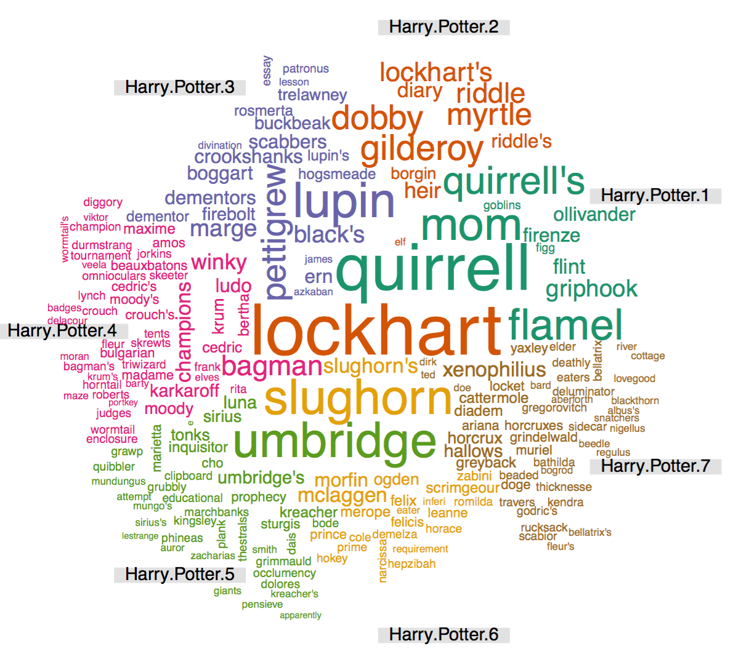
TF-IDF example: Harry Potter
http://casualconc.blogspot.com/

Slide 20
Limitations of frequency statistics
Often favors frequent (TF) or rare (IDF) terms
Still not clear that these provide best description
A “bag of words” ignores additional information
Grammar / part-of-speech
Position within document
Recognizable entities
Typically focus on unigrams (single terms)

Slide 21
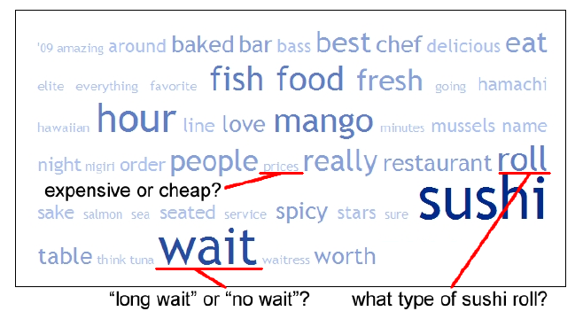
Example: Yelp reviews
Yatani 2011

Slide 22
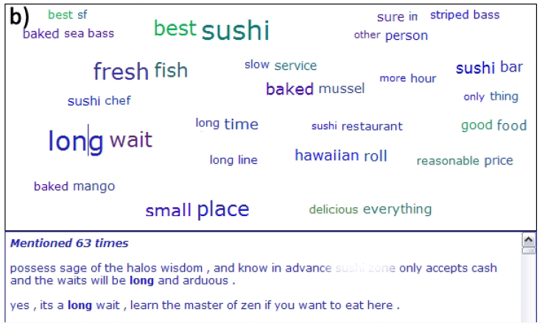
Example: Yelp reviews
Yatani 2011

Slide 23
Tips: descriptive keyphrases
Understand the limitations of your language model
Bag of words:
Easy to compute
Single words
Loss of word ordering
Select appropriate model and visualization
Generate longer, more meaningful phrases
Adjective-noun word pairs for reviews
Show keyphrases in context

Slide 24
Discussion
What are some other ways we might
visualize text data?

Slide 25
Lab 9: working with text in Tableau
Instructions for today’s lab are available at:
http://www.science.smith.edu/~jcrouser/SDS136/labs/lab9
We’ll be working with data from several famous novels available through Project Gutenberg:
“A Tale of Two Cities” by Charles Dickens
“Little Women” by Louisa May Alcott
“Alice’s Adventures in Wonderland” by Lewis Carroll
“Jane Eyre” by Charlotte Bronte
“The Arabian Knights” as translated by Sir Richard Burton
“Don Quixote” by Miguel de Cervantes
To get credit for this lab, use your visualization to identify one interesting feature or trend in this dataset and post to Piazza

Slide 26
Up next
FP3 due tonight by 11:59pm
Thursday: Smith College Museum of Art

